Slide 1
CHEMISTRY –CLASS XII
UNIT XII-ALDEHYDES, KETONES AND CARBOXYLIC ACIDS
PART-III
[Carboxylic acids: Nomenclature, preparation , physical properties, chemical properties and uses ]

Slide 2

Outline
CARBOXYLIC ACIDS
Review of previous session
What are carboxylic acids?
Nomenclature of carboxylic acids
Structure of the carboxyl group
Methods of preparation of carboxylic acids
Physical properties of carboxylic acids
Chemical properties of carboxylic acids
Uses of carboxylic acids
R O PUNE

Slide 3
Review of the previous session
Let us recall the important reactions of aldehydes and ketones such as
nucleophilic addition reactions,
reduction,
oxidation,
Aldol and cross aldol condensation,
Canizzaro reaction etc.
Also we have covered the important uses of aldehydes and ketones
In this session we are discussing about another class of carbonyl compounds, carboxylic acids, most of which are naturally occurring carbon compounds
R O PUNE

Slide 4
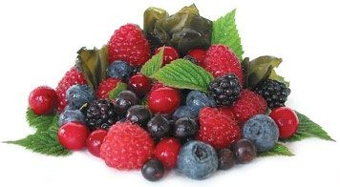
What are carboxylic acids?
Carbon compounds containing a carboxyl functional group –COOH are called carboxylic acids
In carboxylic acids the carbonyl carbon is bonded to oxygen atom of hydroxyl group
Higher members are also called as fatty acids, occur in natural fats and oils as esters of glycerol.
R O PUNE

Slide 5
Nomenclature of carboxylic acids
Common names of carboxylic acid are obtained from the Latin or Greek names of their natural sources
IUPAC names of carboxylic acids are given by replacing ending ‘e’ of the corresponding alkane by suffix ‘oic acid’
R O PUNE

Slide 6
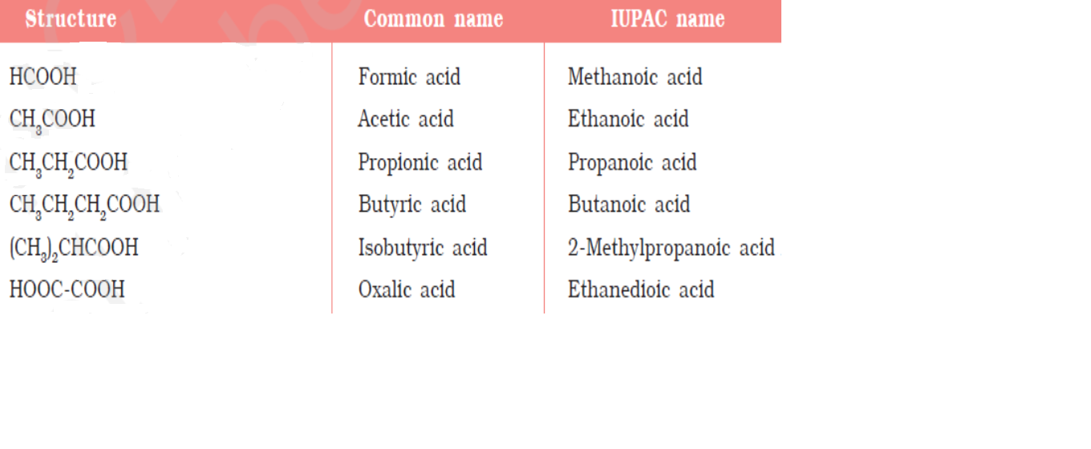
R O PUNE

Slide 7
Nomenclature of carboxylic acids……..
R O PUNE

Slide 8
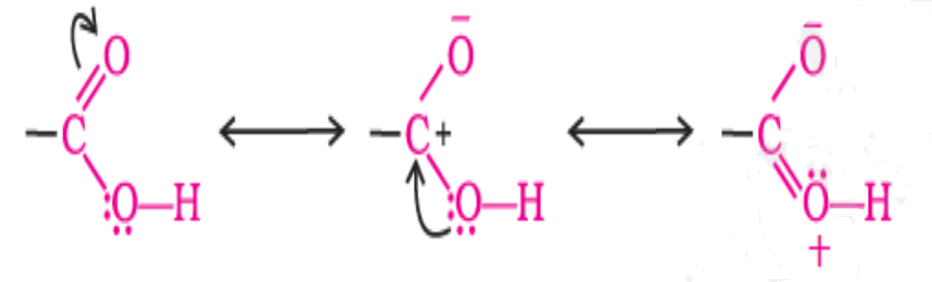
Structure of the carboxyl group
R O PUNE

Slide 9
Methods of preparation of carboxylic acids
1. From primary alcohols and aldehydes
2. From alkyl benzenes
3. From nitriles and amides
4. From Grignard reagent
5. From acyl halides and anhydrides
6. From esters
R O PUNE

Slide 10
Methods of preparation of carboxylic acids……
From primary alcohols
and aldehydes
R O PUNE

Slide 11
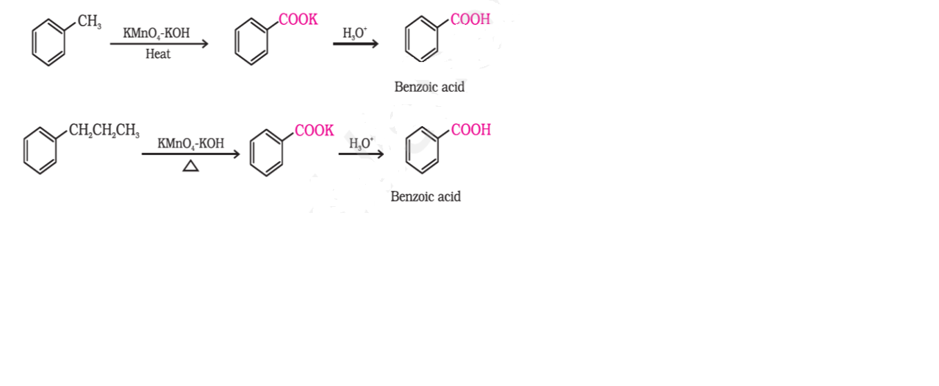
Methods of preparation of carboxylic acids……
2. From alkyl benzenes
R O PUNE

Slide 12
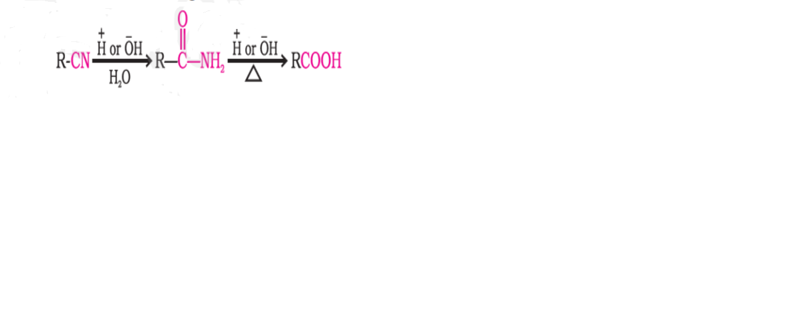
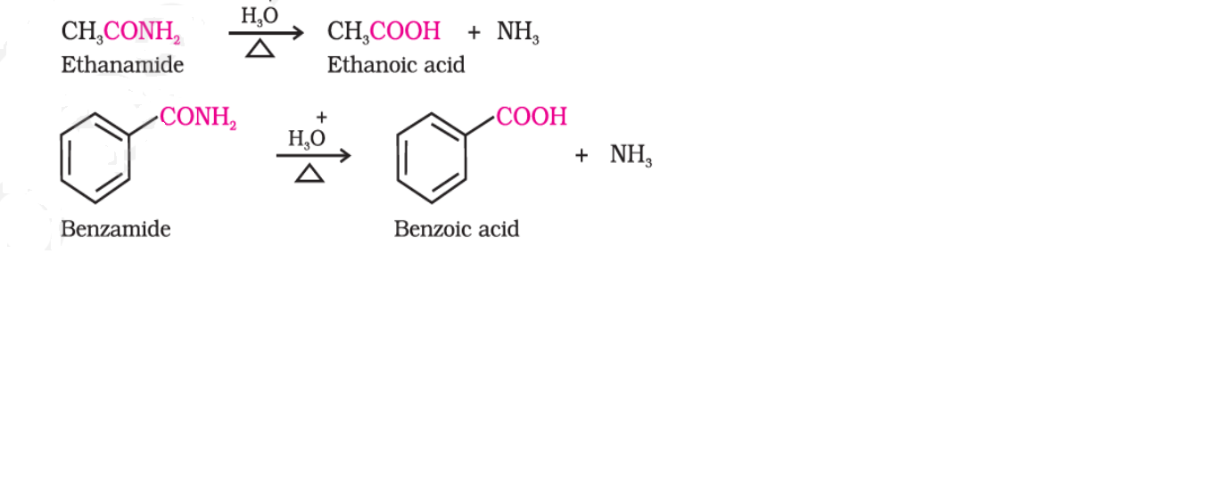
Methods of preparation of carboxylic acids……
3.a) From
nitriles
b) From
amides
R O PUNE

Slide 13
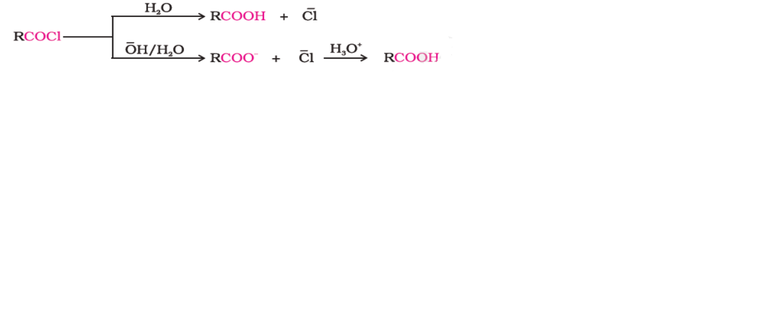
Methods of preparation of carboxylic acids……
4. From Grignard
reagent
5. a) From acyl
halides
R O PUNE

Slide 14
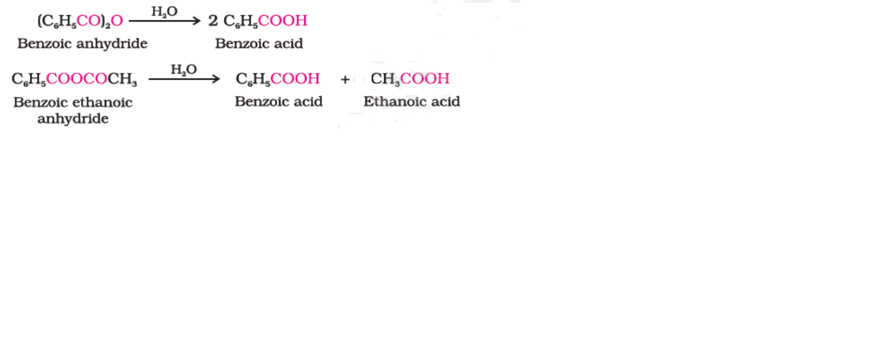
Methods of preparation of carboxylic acids……
b) From anhydrides
R O PUNE

Slide 15
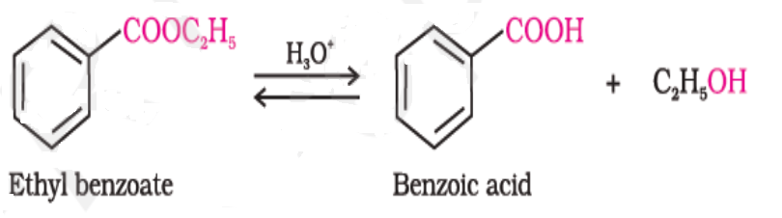
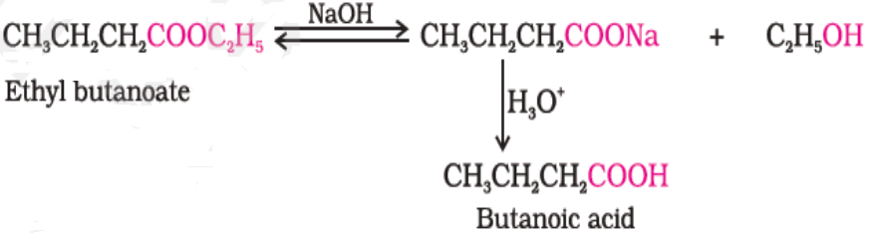
Methods of preparation of carboxylic acids……
6. From esters
R O PUNE

Slide 16
Physical properties of carboxylic acids
Boiling point : Carboxylic acids > alcohols > aldehydes, ketones
Reason: This is due to more extensive intermolecular
hydrogen bonding between acid molecules.
The hydrogen bonds are not broken even in
the vapour phase. In fact, most of the
carboxylic acids are existing as dimer in the
vapour phase.
R O PUNE

Slide 17
Physical properties of carboxylic acids
Solubility: Lower members are miscible in water due to
formation of hydrogen bonds with water
R O PUNE

Slide 18
ChProperties of carboxylic acids
Reactions involving cleavage of O-H bond
Acidity:Reactions with metals and alkalies
Effect of substituents on the acidity of
carboxylic acids
B) Reactions involving cleavage of C-OH bond
i) Formation of anhydride
ii) Esterification
iii) Reactions with PCl3 PCl5 and SOCl2
iv) Reaction with ammonia
R O PUNE

Slide 19
ChProperties of carboxylic acids
C) Reactions involving –COOH group
i) Reduction
ii) Decarboxylation
Substitution reactions in the Hydrocarbon part
i) Halogenation
ii) Ring substitution
R O PUNE

Slide 20
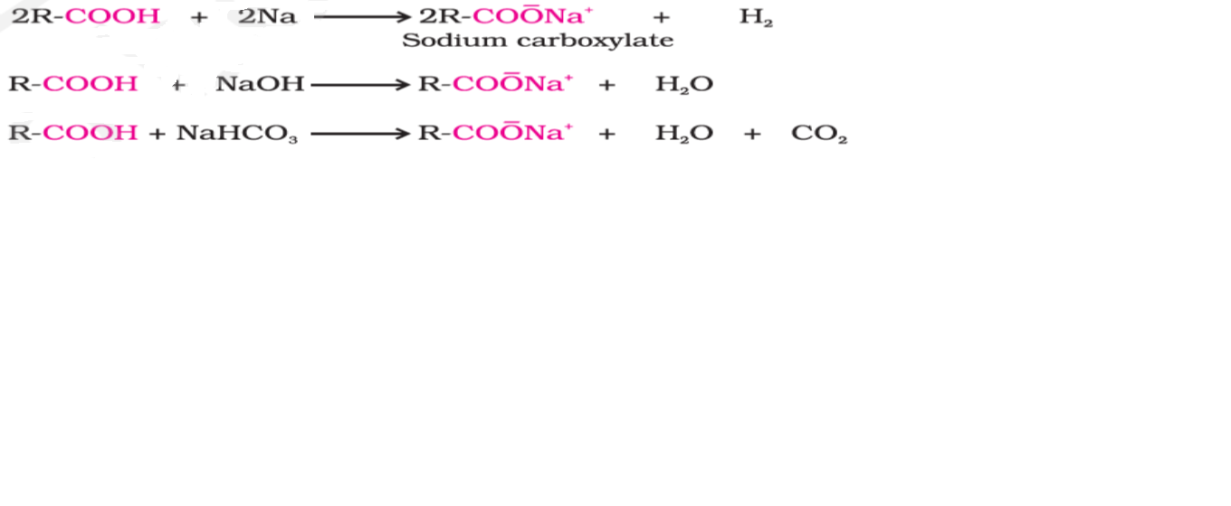
Chemical properties of carboxylic acids……….
Reactions involving cleavage of O-H bond
Acidity:Reactions with metals and alkalies
R O PUNE

Slide 21
Chemical properties of carboxylic acids……….
Reactions involving cleavage of O-H bond
Acidity:Reactions with metals and alkalies
Carboxylic acids are more acidic than alcohols and phenols, why?
Reason: Resonance stabilization of carboxylate anion
R O PUNE

Slide 22
Chemical properties of carboxylic acids……….
Reactions involving cleavage of O-H bond
Effect of substituents on the acidity of
carboxylic acids
R O PUNE

Slide 23
Chemical properties of carboxylic acids……….
Reactions involving cleavage of O-H bond
Effect of substituents on the acidity of carboxylic acids
R O PUNE

Slide 24
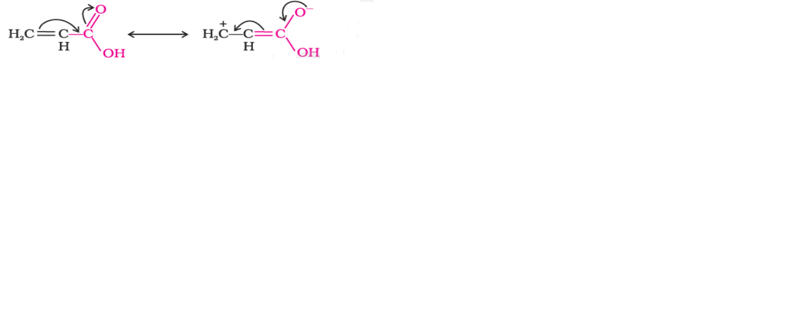
Chemical properties of carboxylic acids……….
Reactions involving cleavage of O-H bond
Effect of substituents on the acidity of carboxylic acids
Direct attachment of phenyl or vinyl group increases the acidity contrary to the decrease expected due to resonance effect
This is because of sp2
hybridized carbon
attached to carboxyl group.
R O PUNE

Slide 25
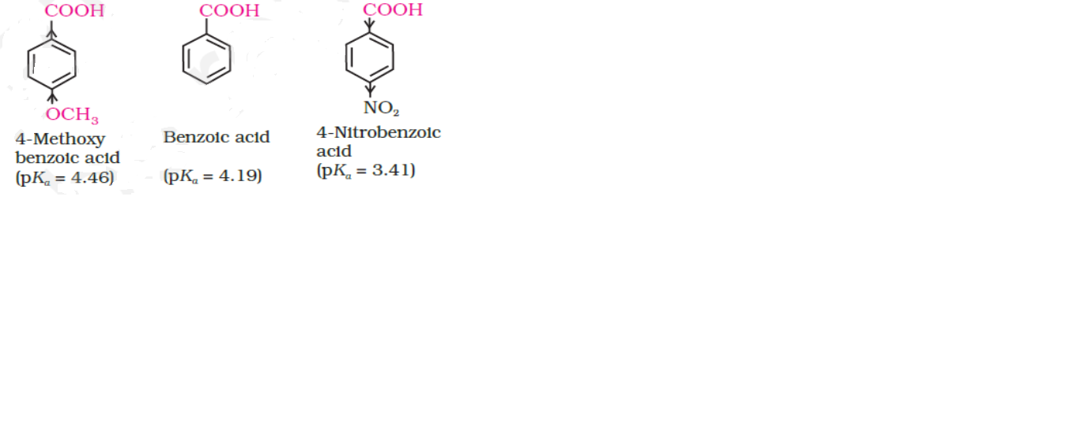
Chemical properties of carboxylic acids……….
Reactions involving cleavage of O-H bond
Effect of substituents on the acidity of carboxylic acids
EWG increases the
acidity of aromatic acids
R O PUNE

Slide 26
Chemical properties of carboxylic acids…….
B) Reactions involving cleavage of C-OH bond
i) Formation of anhydride
ii) Esterification
R O PUNE

Slide 27
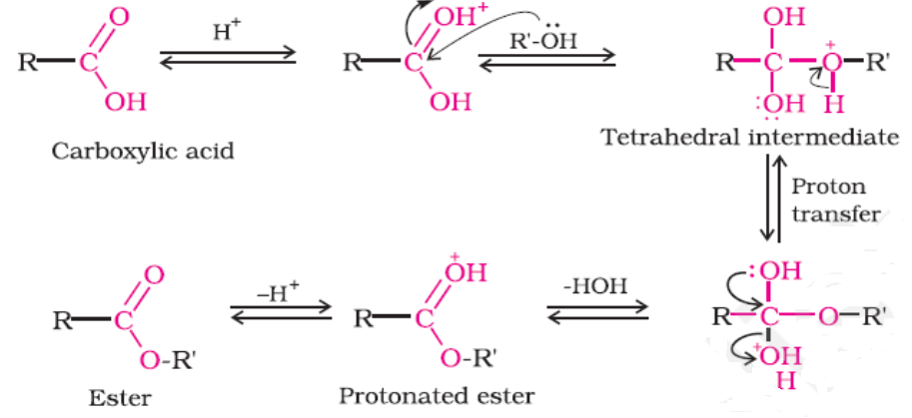
Chemical properties of carboxylic acids…….
Mechanism of esterification
R O PUNE

Slide 28
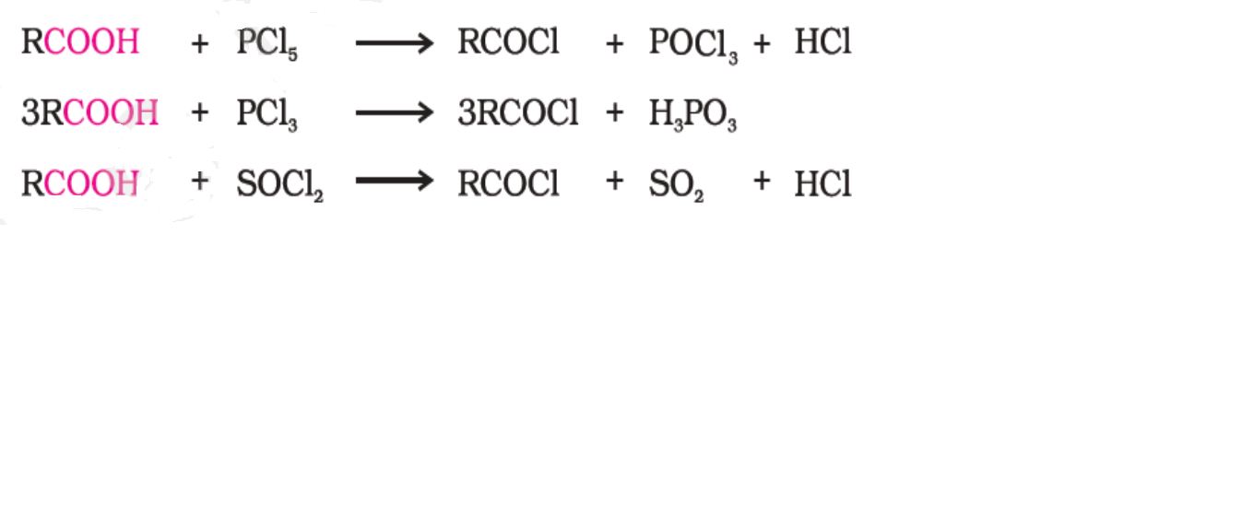
Chemical properties of carboxylic acids…….
B) Reactions involving cleavage of C-OH bond
iii) Reactions with PCl3 PCl5 and SOCl2
R O PUNE

Slide 29
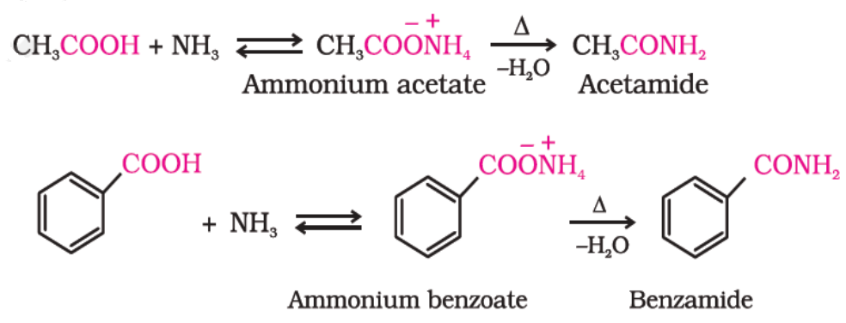
Chemical properties of carboxylic acids…….
B) Reactions involving cleavage of C-OH bond
iv) Reaction with ammonia
R O PUNE

Slide 30
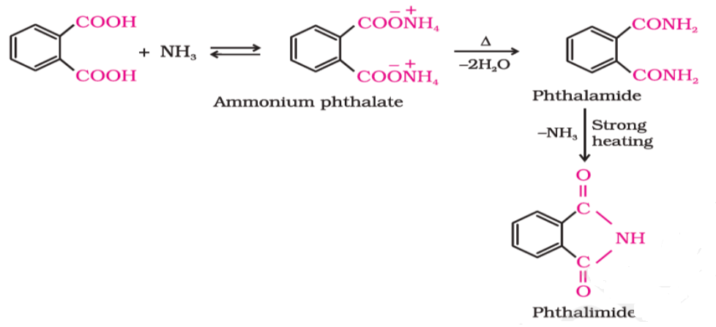
Chemical properties of carboxylic acids…….
B) Reactions involving cleavage of C-OH bond
iv) Reaction with ammonia
Synthesis of phthalimide
R O PUNE

Slide 31
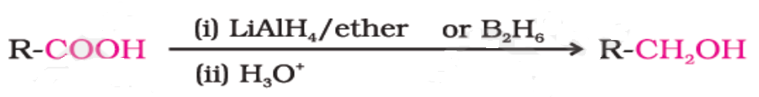
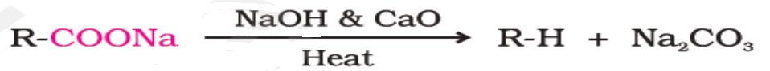
Chemical properties of carboxylic acids…….
C) Reactions involving –COOH group
i) Reduction
ii) Decarboxylation
R O PUNE

Slide 32
Chemical properties of carboxylic acids…….
Substitution reactions in the Hydrocarbon part
i) Halogenation: Hell –Volhard –Zelinsky reaction
ii) Ring substitution
R O PUNE

Slide 33
Uses of carboxylic acids
1.Methanoic acid - rubber, textile,dyeing,leather and
electroplating industries
2. Ethanoic acid- solvent, food preservative
3. Benzoic acid- food preservative and perfume
4. Fatty acid- soaps and detergent
R O PUNE

Slide 34
Summary
In this session we have studied
nomenclature,
preparation methods
important reactions of carboxylic acids
Also we have covered the important uses of carboxylic acids
R O PUNE

Slide 35
Thank you

